Slide 1
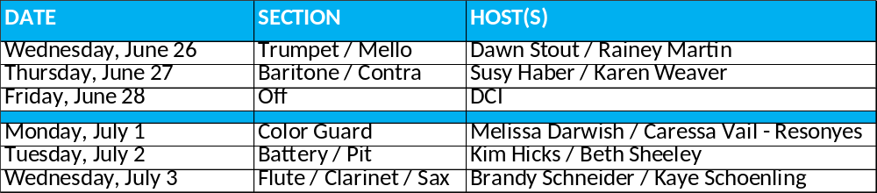

Fan Club Meet & Greet at 2-9’s
Join us 8:30p-9p for a sweet treat while waiting to pick up your marcher from 2-9’s. Get to know other parents within your marcher’s section.
You can ask for tips to navigate through all things marching band. Arrange a car pool. Talk about section parties. Create a group text to communicate upcoming events. Organize a ride share to contests. Get the 411 on volunteering. Chat about other performing arts classes / events.
Have fun because it’s a long season and we are all in this together!
Look for us under a canopy next to the shed on the left side of the parking lot immediately past marching band drop off. If raining, look for location sign on Door 16.

