Slide 1

Booster Break-out Session: Lawrence Central

Slide 2

When your child participates in the performing arts at Lawrence Central High School, including participating in the Marching Pride of Lawrence Township, you are a member of the Lawrence Central Performing Arts Association.
LCPAA covers expenses above and beyond funds provided by the district.
LCPAA is a non-profit 501 (c) (3) corporation.
You are welcome and encouraged to attend full board meetings which are the first Monday of every month. The meetings take place in the LC Choir Room at 6:45p. Our next board meeting is on July 15th. The first board meeting of the new school year will be on August 5th.

Slide 3
Volunteering
To earn money for the performing arts department, each family is expected to provide a reliable adult volunteer for (3) fundraising shifts during the school year.
This volunteer shift may be for any performing arts event.
The work you do for your child’s performing arts group (i.e. marching band) to assist with uniforms, crew, chaperoning, meals, etc., is truly appreciated, but does not count towards your fundraising volunteer shift.

Slide 4
2019-2020 LCPAA Fundraising Opportunities
To earn money for your student’s account, you will have these opportunities for the upcoming school year:
Student fundraising: Yankee Candles, trash bags, mums, poinsettias, spring flowers, Crew Car Wash, Popcornopolis, etc.
Ad campaign – sell ads that will appear in performing arts programs
Scrip
LCPAA Gala – a special event to raise money for scholarships. It will be held on Saturday, September 7th from 7-9p. Contact Dawn Stout president@lcpaa.org for additional information.

Slide 5
Payment Options
Payment Plans – Contact the Performing Arts Office to arrange a payment plan.
Credit Card Option – Pay quota and fees over the phone, in person by check or credit card, or online through LCPAA website (http://www.lcpaa.org/online-payments/)
Additional Class Fees – All classes have fees and possible instrument rental fees, travel fees, and cost of shoes.
Scholarship Opportunities – Contact Performing Arts Office.
Season Pass – All students whose fees are paid by Monday, September 9, 2019, will obtain one season pass which entitles you to (1) ticket to a variety of LCPAA events. See website for details.

Slide 6
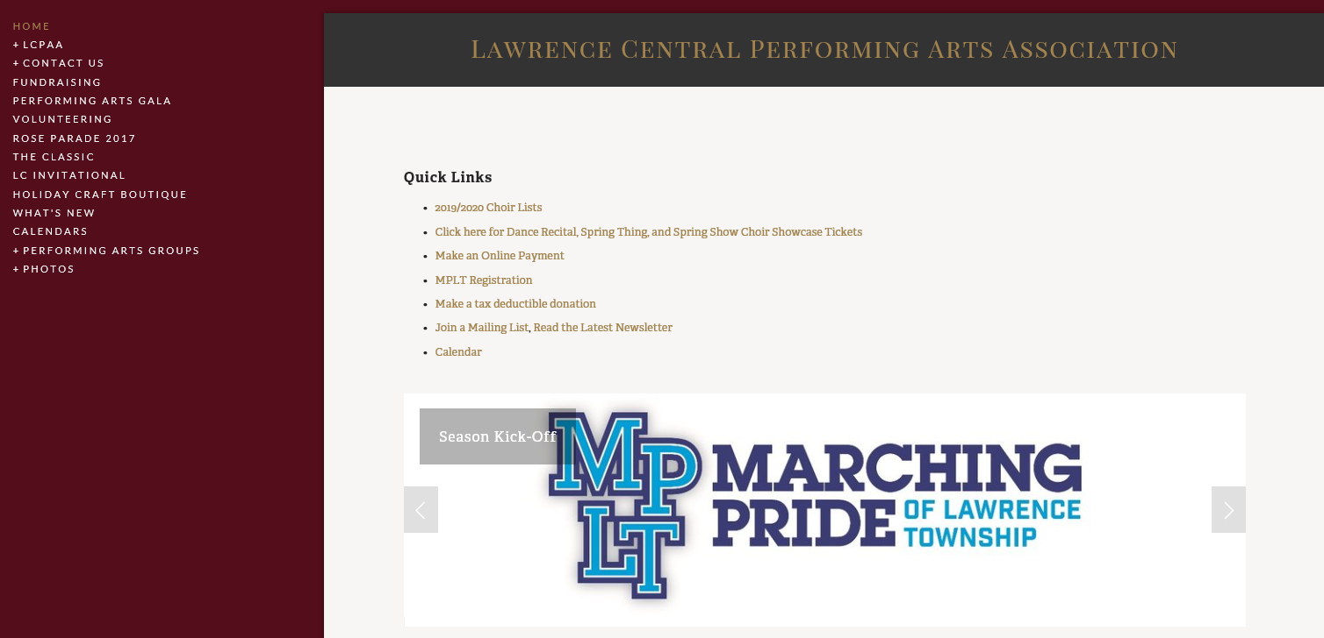
Website

Slide 7
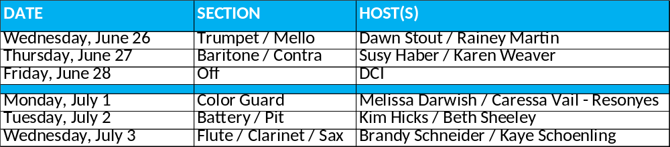
Fan Club Meet & Greet at 2-9’s
Join us 8:30p-9p for a sweet treat while waiting to pick up your marcher from 2-9’s. Get to know other parents within your marcher’s section.
You can ask for tips to navigate through all things marching band. Arrange a car pool. Talk about section parties. Create a group text to communicate upcoming events. Organize a ride share to contests. Get the 411 on volunteering. Chat about other performing arts classes / events.
Have fun because it’s a long season and we are all in this together!
Look for us under a canopy next to the shed on the left side of the parking lot immediately past marching band drop off. If raining, look for location sign on Door 16.

Slide 8
How to get involved
Attend the next LCPAA board meeting on July 15th at 6:45p or the first Monday of every month (Aug-May) at 6:45p in the Choir Room.
  After LCPAA Full Board meeting → August 12 at 6:45pm →Incredibly informative information meeting about LCPAA at 7:30pm in the Senior Cafeteria
Please register for the Listerv on LCPAA.org, LCPAA on FB
If you have any questions, please ask! Contact Performing Arts Admin Melody Pancheri at 317-964-7450 or email melodypancheri@msdlt.k12.in.us
We are all volunteers and proud to be a part of the Marching Pride of Lawrence Township!

